Slide 1
Lifemapper: Biodiversity Modeling Tools to Save the (Natural) World
Aimee Stewart
University of Kansas Biodiversity Institute
http://www.lifemapper.org
Notes:
I am the technical lead on a project called Lifemapper at the University of Kansas in the US.
Some of you may remember Lifemapper in a previous incarnation as a distributed computing project with screensavers computing species distribution maps, along the lines of SETI at Home
We’ve changed and grown since then
At its core, Lifemapper consists of two main components:
First, An archive of species occurrence data, current and predicted climate and environmental data, and modeled habitat maps created from them
And second, a set of tools, published as webservices, for researchers to use with our data, or their own, to study biodiversity of single or multiple species

Slide 2
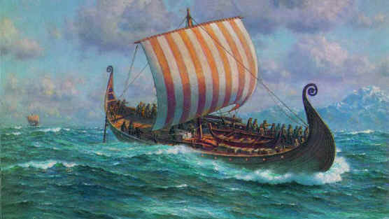
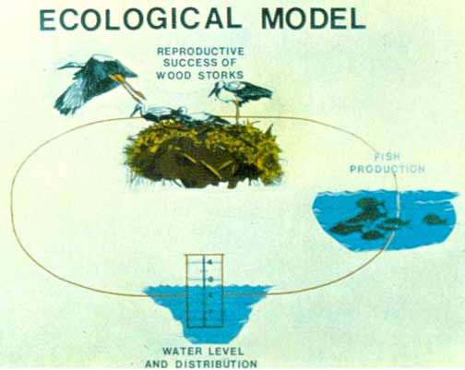
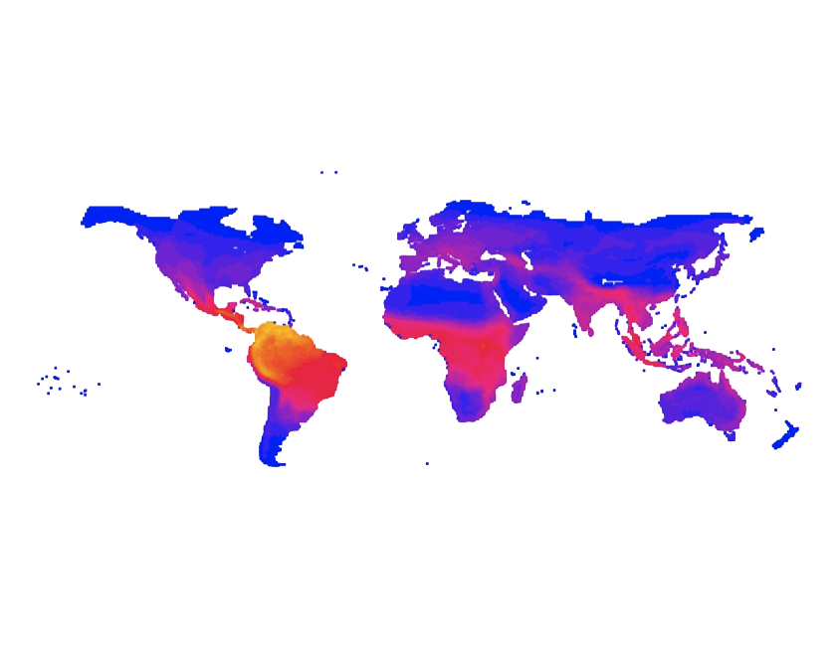
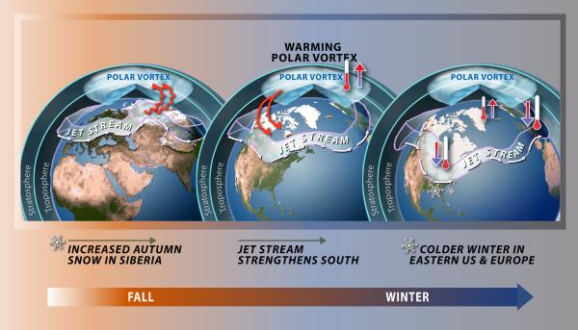
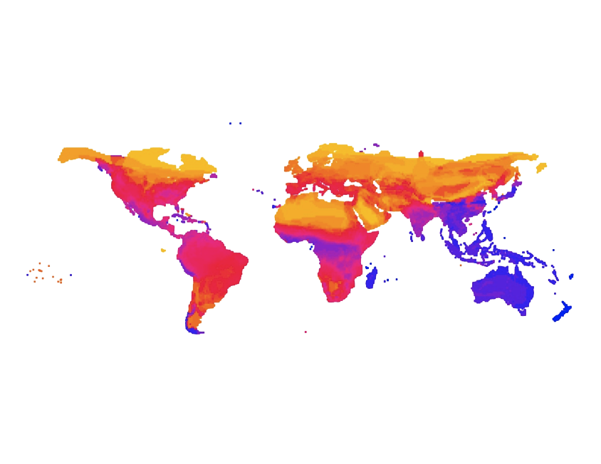
Lifemapper Tools
LmSDM:
Species Distribution Modeling
LmRAD:
Range and Diversity
Notes:
The tools are aimed at several scientific communities and can be divided into
The Species Distribution Modeling or LmSDM tools can be used by
The Biodiversity inventory and documentation community . Over the last 300 years Scientists and Explorers have been documenting life on earth and have collected over 3 billion specimens, but even with recent digitization efforts, maybe only 1/3 of them have been digitized and somewhat fewer have been georeferenced. With Species Distribution Modeling, scientists can use the data that is available to model other areas where conditions are favorable for that species to live.
Scientists can project those models onto the outputs of Global Climate Models (GCMs) to predict habitat gains or losses based on different scenarios of global economic development and the climate change that could impact biological systems.
The Range and Diversity tools, or LmRAD, can be used by
The Ecological Modeling community for looking at the relationships between organisms and their environment at large and varying geographic scales, to explain statistical patterns of abundance, distribution and diversity

Slide 3
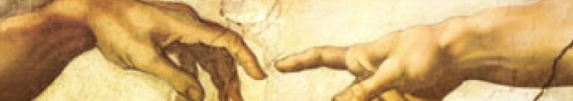
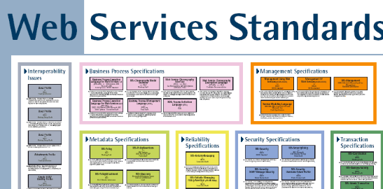

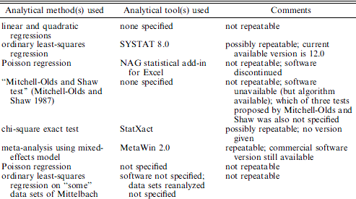

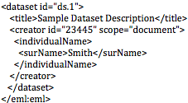
Integrate & Catalog for Transparent, Repeatable Science
Integration
Repeatable Transparent Science
Archiving
Ellison, A. 2010. J. Ecology
EEML
Notes:
Our goal is a software infrastructure with tools useful for all these communities. The tools are modular and allow open access to streamline difficult and time-consuming tasks.
We use standard protocols and formats
To Integrate scientific data and analyses in clients, such as scientific workflow or GIS tools
To Archive and document data, tools, metadata, and entire research experiments in public repositories
To allow creative, transparent, repeatable science.

Slide 4





Lifemapper Services
Web Services
QuantumGIS
Data
VisTrails
Internet
Metadata
Analysis
Visualization
Narrative
Notes:
So - We are building infrastructure not science. But like all good infrastructure, it’s invisible when it works
It connects data, tools and metadata in standard formats with standard protocols, for modeling, analyzing, and visualizing species distributions and biodiversity
These are published through web services, allowing anyone to access them with a simple URL
Metadata allow the discovery, query, retrieval, and re-execution of research experiments plus construction of simple narratives or stories describing the steps in an experiment.
We have written plugins for software applications to communicate with the web services
We will also publish our data and services as a DataONE Node when it is online. DataONE is a 10-year US NSF-funded scientific data infrastructure project that will replicate data and metadata with standard formats and interfaces.
My key point is that Lifemapper is web service and standards based, independent applications and researchers can put the tools and data together in novel ways, and modify and re-execute experiments to answer new questions

Slide 5

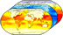



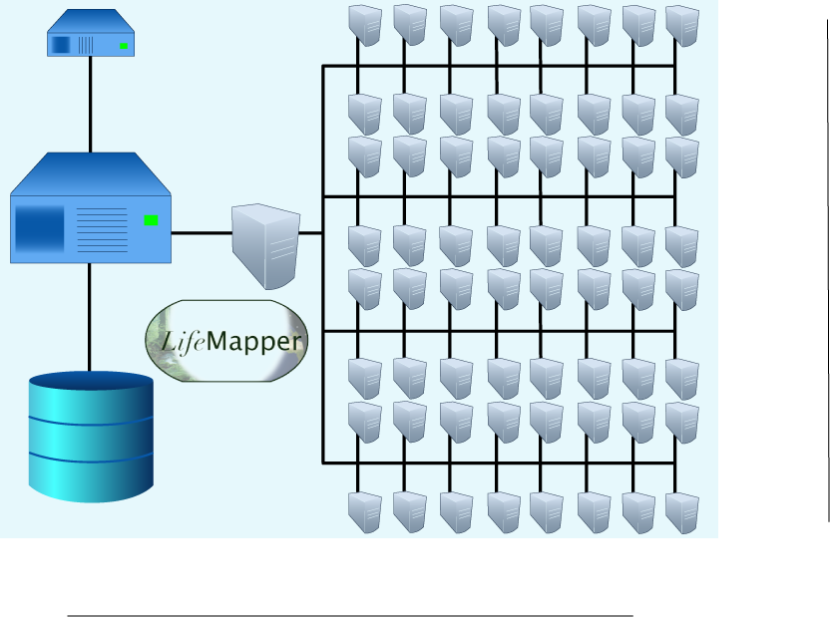
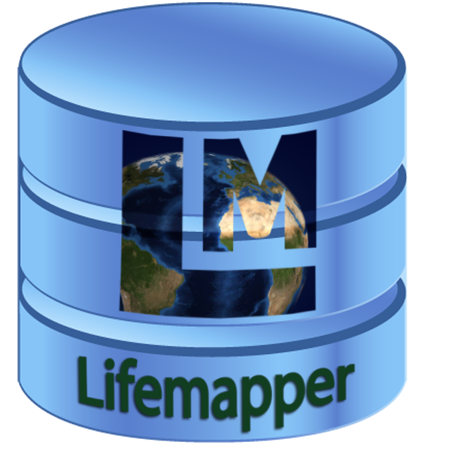

Lifemapper Back-end
Pipeline
Data Archive
Compute Resources
Notes:
The LM Servers can be split into the Back end and the Front end and Clients
The Back-end is Data Archive, a Compute Engine and a Pipeline moving things between the two
Data repository, or Archive, is a local system to keep track of location of data and stage of analysis. It uses PostgreSQL, an open-source database spatially enabled with PostGIS
Occurrence data aggregated by Global Biodiversity Information Facility or GBIF from biological museums, collections and observation databases. This is digital data about specimens
Observed climate data – elevation and bioclimatic variables from the WorldClim dataset of interpolated monthly climate layers
Predicted climate data – Global Climate Model, or GCM, outputs, calculated by modeling centers based on the Intergovernmental Panel on Climate Change (IPCC) scenarios
Predicted species distribution maps calculated from the specimen and climate data
The Compute Engine is currently a 64 Node Compute Cluster at KU
The Pipeline connects the data archive and the computational processes by monitoring the system for user-requested experiments or updated specimen data from GBIF.
All of the Lifemapper infrastructure and tools are written in Python. That is a very nice high-level language that is open-source and cross-platform.

Slide 6

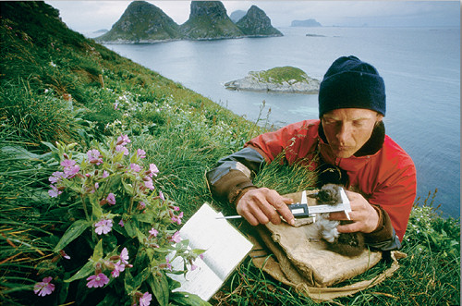


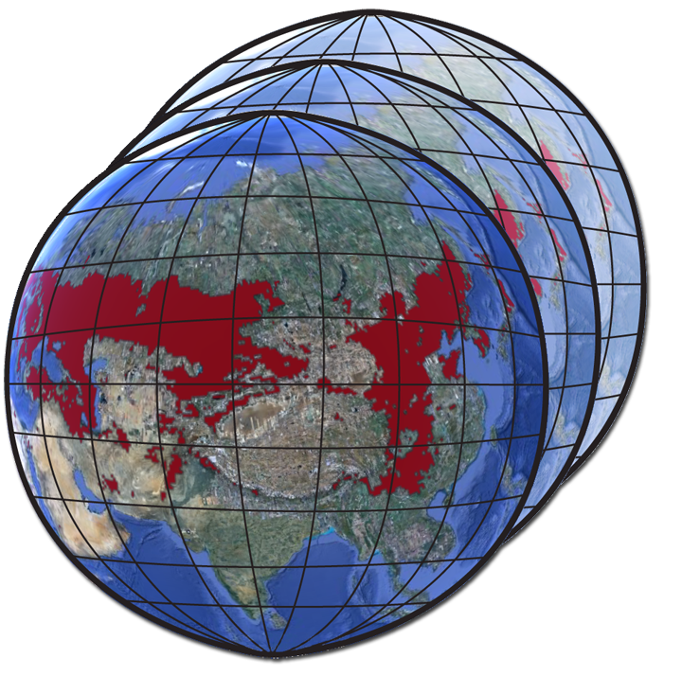
Lifemapper Clients
Clients
Research
Internet
Notes:
The Front-end consists of Web Services publishing the data, metadata, and analysis tools
We use MapServer to serve all archive inputs and outputs using OGC standards and OpenLayers to display maps on the website
We create Metadata – with a subsystem that collects information at every step of the process for public cataloging so data can be discovered, queried, shared
We produce metadata in Ecological Metadata Language, or EML, a standard for the Ecological community and one of the first standards supported by DataONE
We also will publish to broader and alternative repositories – such as simply being indexed and searchable by Google
Finally, we have Client applications that communicate with LM webservices, ;this is made easier by our adherence to standard protocols and formats
We’ve written plugins for two clients so far:
VisTrails a free, open-source, and cross platform scientific workflow environment, well-supported by NSF and the project developers.
And QuantumGIS, or QGIS, a powerful Geographic Information System, or GIS, also free, open source and cross-platform.
Both run on Windows, Mac OSX and Linux.
Both use the same client library which should be available for download by the end of the month
The common library simplifies access from other applications as well – developers can incorporate the library directly, or use it as a jump start to writing their own connectors

Slide 7
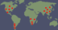
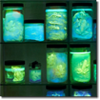


LmSDM: Species Distribution Modeling
Species Occurrence Data
SDM Modeling Algorithm
Predicted Habitat
Environmental Data
Notes:
We currently have 2 sets of tools – the first is Species Distribution Modeling or LmSDM
LmSDM calculates predicted habitat models using occurrence and environmental data and an OS software framework called openModeller, created by CRIA (Reference Center on Environmental Information) in Brazil
Our primary data source for specimen occurrence data is GBIF. GBIF gives us a copy of their cache approximately once a month. These data are organized by scientific name and available through LM services for download and modeling. Alternatively researchers can upload their own datasets for LmSDM computation
Environmental layers are also served through LM services, including WorldClim elevation and bioclimatic variables and the same bioclimatic variables calculated from predicted future climate values from global climate models

Slide 8
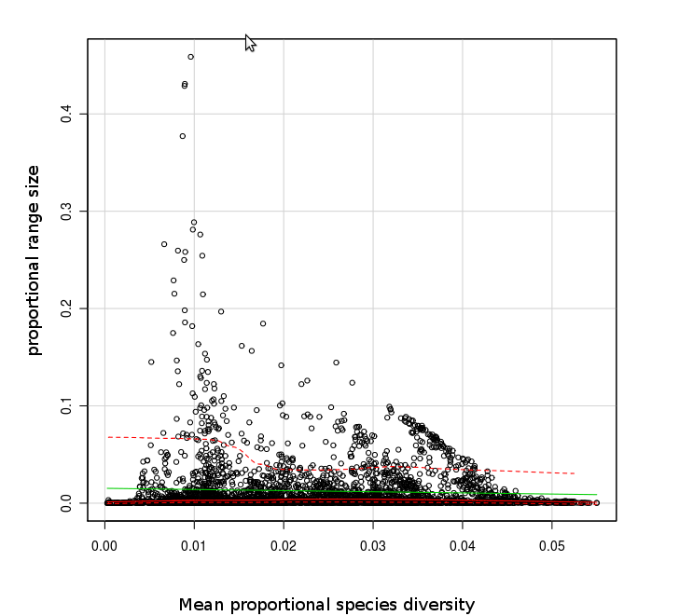
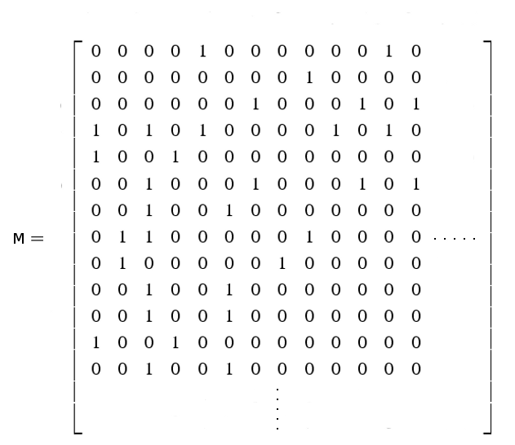
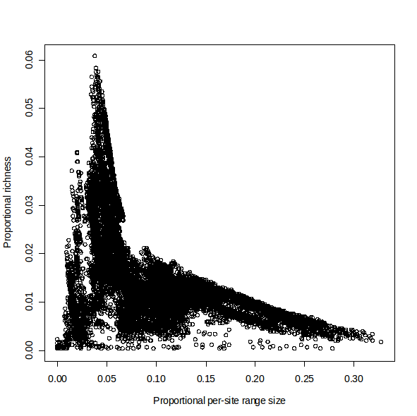
LmRAD: Range and Diversity
Presence Absence Matrix (PAM)
Species Habitat Data
Range and Diversity
Quantifications
Notes:
The second set of tools we are developing are Range and Diversity tools, or LmRAD. These are working on our development servers and should be public when I get home / next month
We begin with geospatial data, representing species habitat ranges for multiple species
These data are all summarized in a Presence Absence Matrix, or PAM: which then contains much of the information needed to understand species diversity.
From the PAM, we have different ways of representing species diversity, such as scatterplots, indices, and other quantifications

Slide 9
Species Distribution and Diversity
Biodiversity patterns
Species abundance, distribution and diversity
Multiple scales and extents
Used for conservation and management decisions
Challenges
Large extents (> 10,000 km2)
Fine resolution (< 1000 km2 ≈ 30km x 30km)
Many species (10,000 +)
Notes:
We are developing these tools to study biodiversity patterns and macroecology
This can be done at different scales, not only geospatial extent and resolution, but also temporal resolution and species resolution – in terms of phylogeny, taxonomy, or other attributes used to classify species
LmRAD will support large amounts of data, from multiple sources, and analyze them at multiple scales

Slide 10
Data Preparation
Add species habitat layers for presence/absence
Intersect each layer with a grid
Flatten the cube into a 2d matrix
Rows = sites (longitude, latitude)
Columns = species
Presence-Absence Matrix aka PAM
Compress the matrix
Notes:
The Data preparation involved in these large-scale experiments can be a very time consuming process and require huge computational resources
First we add species habitat ranges to the data grid, from any data source, they could be
past, present or future
predicted or observed
raster or vector, RS data, range maps, etc
continuous or discrete values

Slide 11
Terrestrial Mammals
Proportional Species Richness
High Yellow
Moderate Red
Low Blue
Per-site Range Size
Notes:
Here are some results from the “Terrestrial Mammals of the World” data, with over 3600 species, compiled over a period of 3 years by Gerardo Ceballos at National University of Mexico, UMAN.
Jorge Soberon and his students at the U of KS Biodiversity Institute then took these data and calculated a PAM from the data.
One principle of species richness and range size is clearly visualized here.
Areas of high species richness, diversity are composed of species with very small range sizes, such as the most diverse area in the world, here in the Andes along the northern portion of South America
Areas where most of the species have large range size, such as the Arctic, have very low species diversity

Slide 12
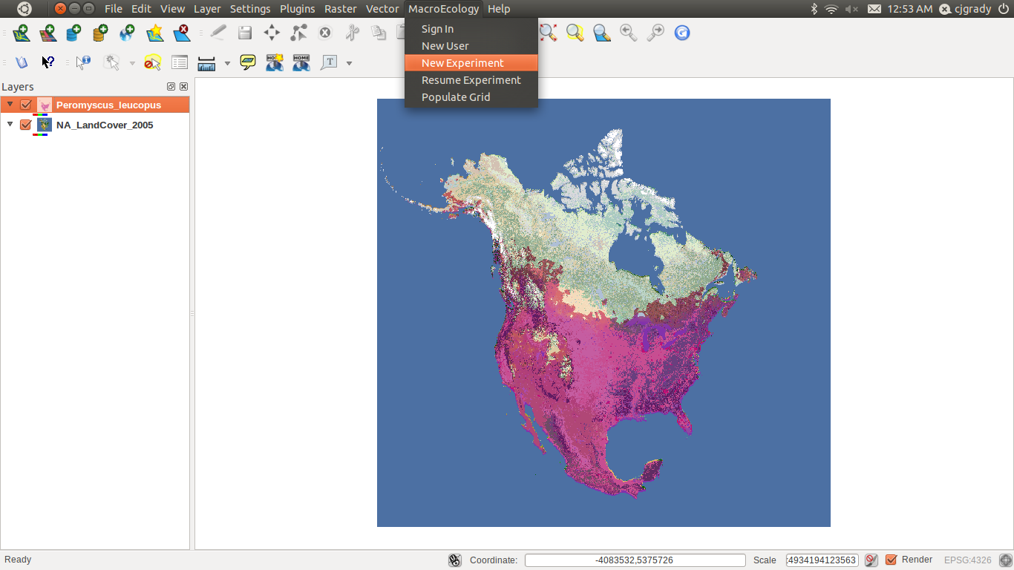
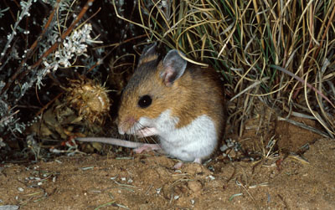
QGIS with Lifemapper MacroEcology plug-in
Notes:
I’m going to show you a couple of screenshots of an experiment using one client application, QuantumGIS, with Lifemapper plugins, communicating with Lifemapper development servers
This shows QGIS displaying a simple NA landcover map, overlaid with a predicted species distribution map for a white footed-mouse, previously computed by LmSDM services, using GBIF occurrence data and environmental data layers. The layer shows the likelihood this mouse is present in a particular area. This is a raster dataset, with values scaled from 0 to 255

Slide 13
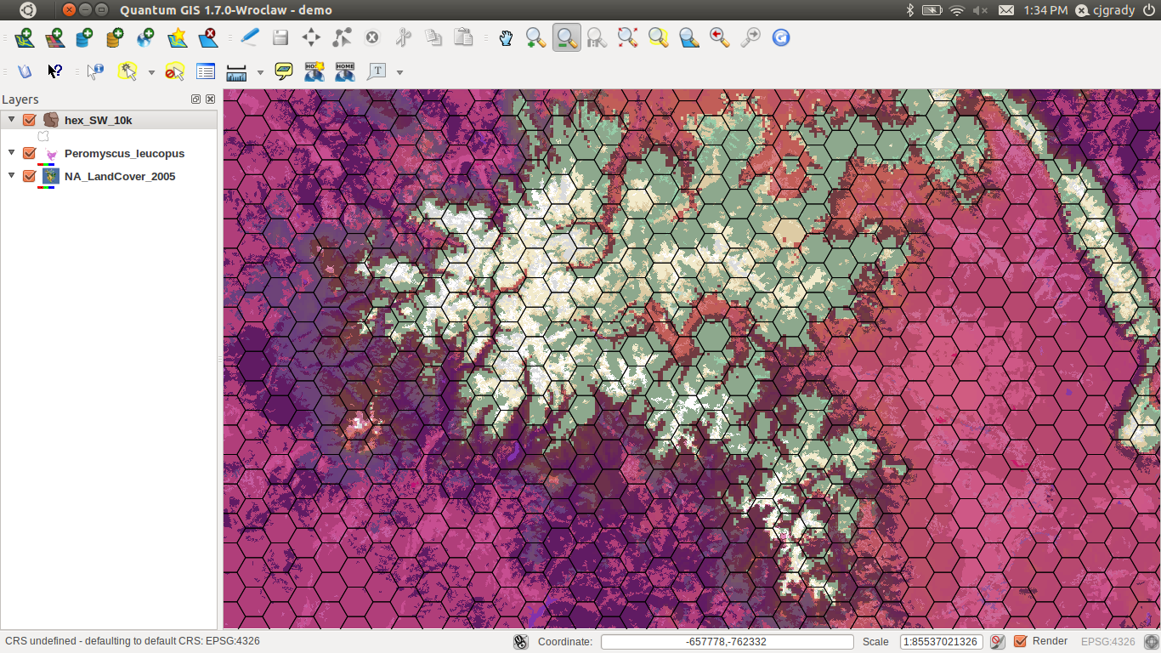
Hexagonal Grid
Notes:
First the researcher creates a data grid – by defining the area, size and shape of the cells
Then the researcher adds species data to an experiment, he/she defines thresholds to calculate ‘Presence’ for each species when intersecting each layer with the Data Grid
This is a call/instruction to a webservice on the remote server through QGIS, and takes a lot of time when done by hand for each species.
We can not only intersect one species, but can do 1,000s of species at once, so automating this step is a huge productivity gain

Slide 14
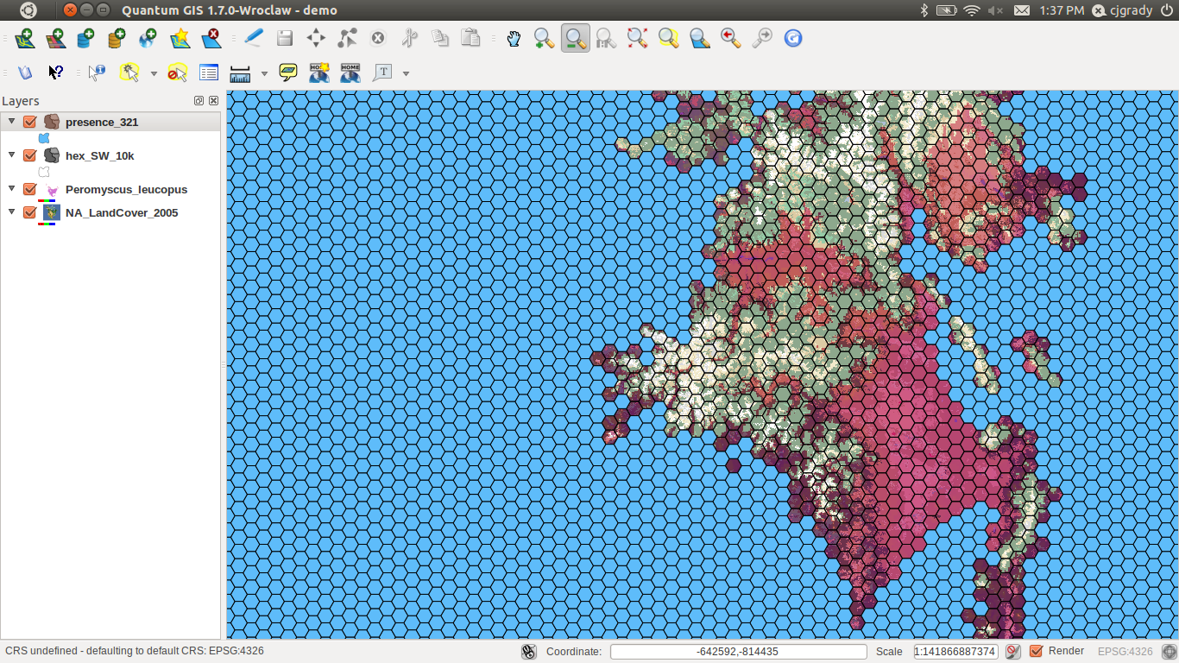
Mouse ‘Presence’
Notes:
The resulting species layer intersected with the data grid here shows the blue hexagons coded Present, all the rest are Absent
Again, the values chosen by the researcher determined which cells were coded present and which absent.

Slide 15
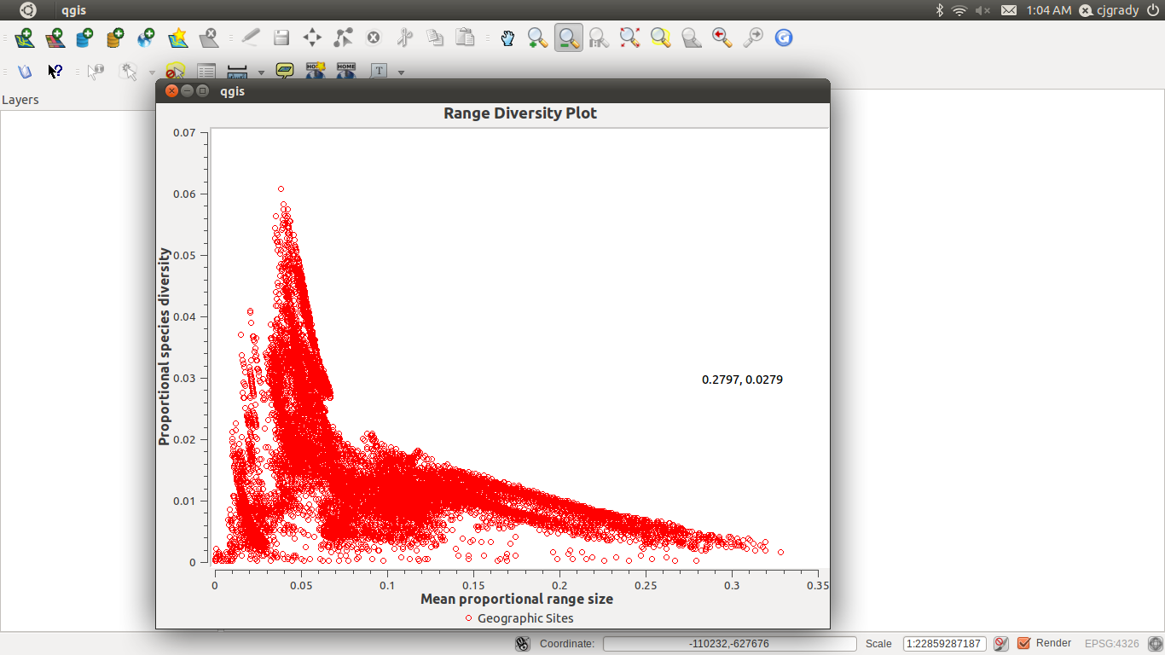
Sites / Species Plot
Notes:
One output of a fully populated experiment is a Range Diversity Plot
This plots the hexagonal cells from the map as circles – so it shows the relationship b/w range size and the number of species w/in each cell
The X axis represents mean range size
The Y axis represents proportional species richness
Previously scientists used several softwares and did lots of data massaging.
We are particularly excited to link these range diversity plots of individual cell values, not only with a map representation of the same cells, but also phylogenetic trees of the species represented in those cells
This will be three linked windows showing the statistics, geography and phylogenetic tree of a dataset

Slide 16
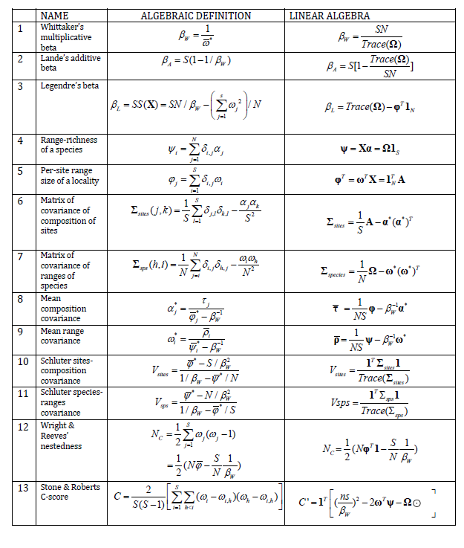
Published Indices
Notes:
This table contains a compilation of the statistics published in the macro-ecological literature summarizing species diversity from our PAM.
Most existing indices of biodiversity pattern are simple combinations of calculations from the PAM, such as
The vectors of:
species richness
sizes of distributions
dispersion fields – summarize co-variance of species
diversity fields
Whitaker’s beta diversity- a scale dependent index that compares local diversity to regional diversity
And the dimensions of the PAM
Additional measures are produced from the PAM, such as
Marginal statistics and co-variances
Sites by Species plot
Species by Sites plot

Slide 17
Metadata!!!
Repeatability and Reproducibility
Provenance of a dataset
Process metadata
Extended EML
Descriptive and prescriptive
EML-Reader in VisTrails and QGIS
Narratives
Notes:
A huge focus of our work now is on Metadata to document an experiment, its inputs, outputs and the methodology
We are working on standardizing the Process metadata, information about the steps taken to create an experiment or modify a data set.
We are working on Extended EML an expansion of the EML process metadata section – and proposing that to their working group as a standard, as well as existing ISO standards and emerging W3C standards
We have written a client module, the EML Reader, to read and re-implement this Extended EML, and plugged it in to QGIS and VisTrails
The EML Reader can then recreate a published experiment in QGIS or VisTrails by accessing the (also published) data and tools
We are also creating simple narratives from the Extended EML, that basically tell the story of the experiment in language targeted to a particular audience
We will publish the EML to make that data and research available in a public catalog
That will be DataONE when it is online,
But as alternative, we’re now publishing to a public directory where it is indexed by Google

Slide 18






ELSeWEB
Notes:
A new collaboration is focused on capture end-to-end provenance using semantic web methods, creating ontologies and knowledge bases for each partner so that user queries can be translated across platforms
It also expands the environmental layers we provide to include NASA Earth observational data through this partnership with
University of New Mexico (UNM) Earth Data Analysis Center (EDAC) and
University of Texas at El Paso (UTEP) Cyber-ShARE Center.

Slide 19
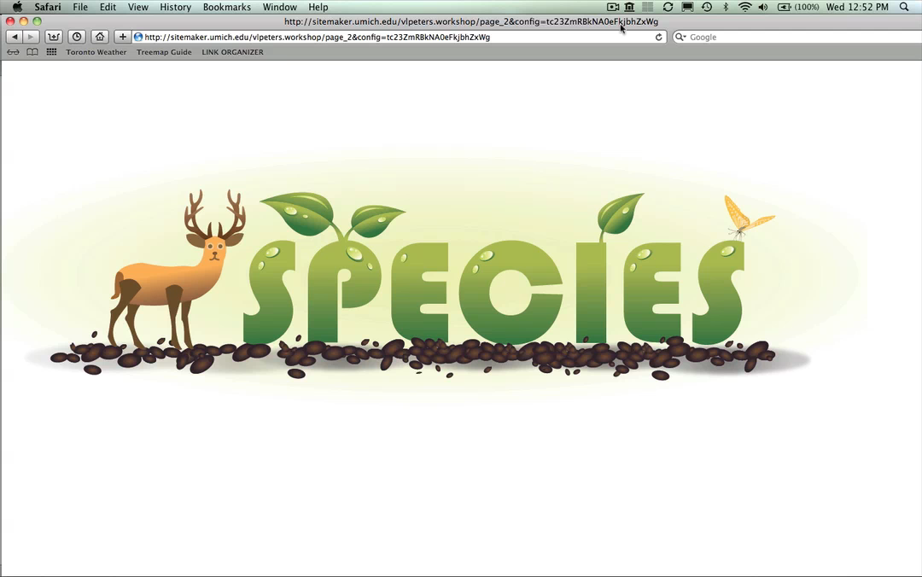
Education Outreach
ChangeThinking
Impacts of Climate Change
Learning Progressions
Coordinated
Curriculum
Tools
Assessment products
Promote complex reasoning
Notes:
One audience we are considering for narratives is teachers, for use in science education materials in a project called Change Thinking for Global Science
The goal is to teach students about the impacts of climate change on species distribution and ecosystem dynamics using LM predicted habitat maps
Online workbooks lead students in grades 7 through 10 through exercises to develop complex reasoning skills

Slide 20

Mix and Match
Web Services
QuantumGIS
Data
VisTrails
Internet
Metadata
Analysis
Visualization
Narrative
Notes:
As the Lifemapper project has matured and expanded, the importance of a flexible codebase has become increasingly apparent. The Lifemapper project follows the object-oriented programming paradigm, with particular emphasis on modularity, inheritance, and data abstraction.

Slide 21

Lifemapper funded by:
U.S. National Science Foundation NSF EPSCoR 0553722
NSF EPSCoR 0919443
EHR/DRL 0918590
BIO/DBI 0851290
OCI/CI-TEAM 0753336
http://www.lifemapper.org
astewart@ku.edu
Notes:
This work is funded by the United States
National Science Foundation and
National Aeronatics and Space Administration

